Slide 1

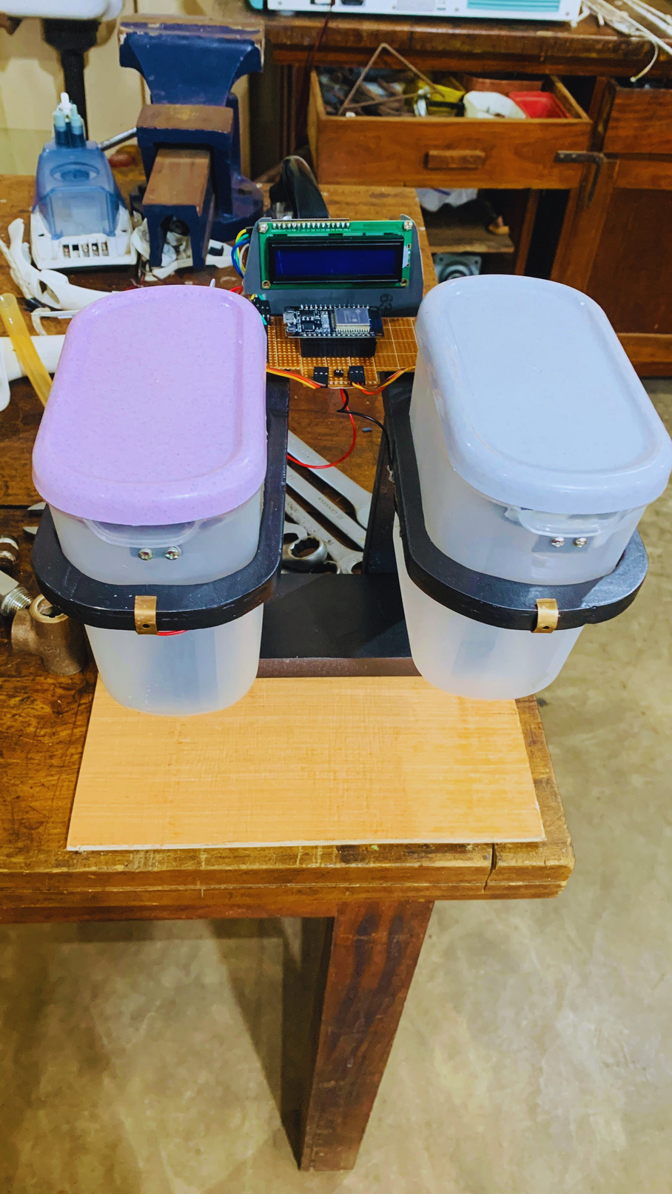
KITCHEN INVENTORY MONITORING SYSYTEM
Index No : AS2021926
Name : N.L.M.ARACHCHI
4 DECEMBER 2024

Slide 2
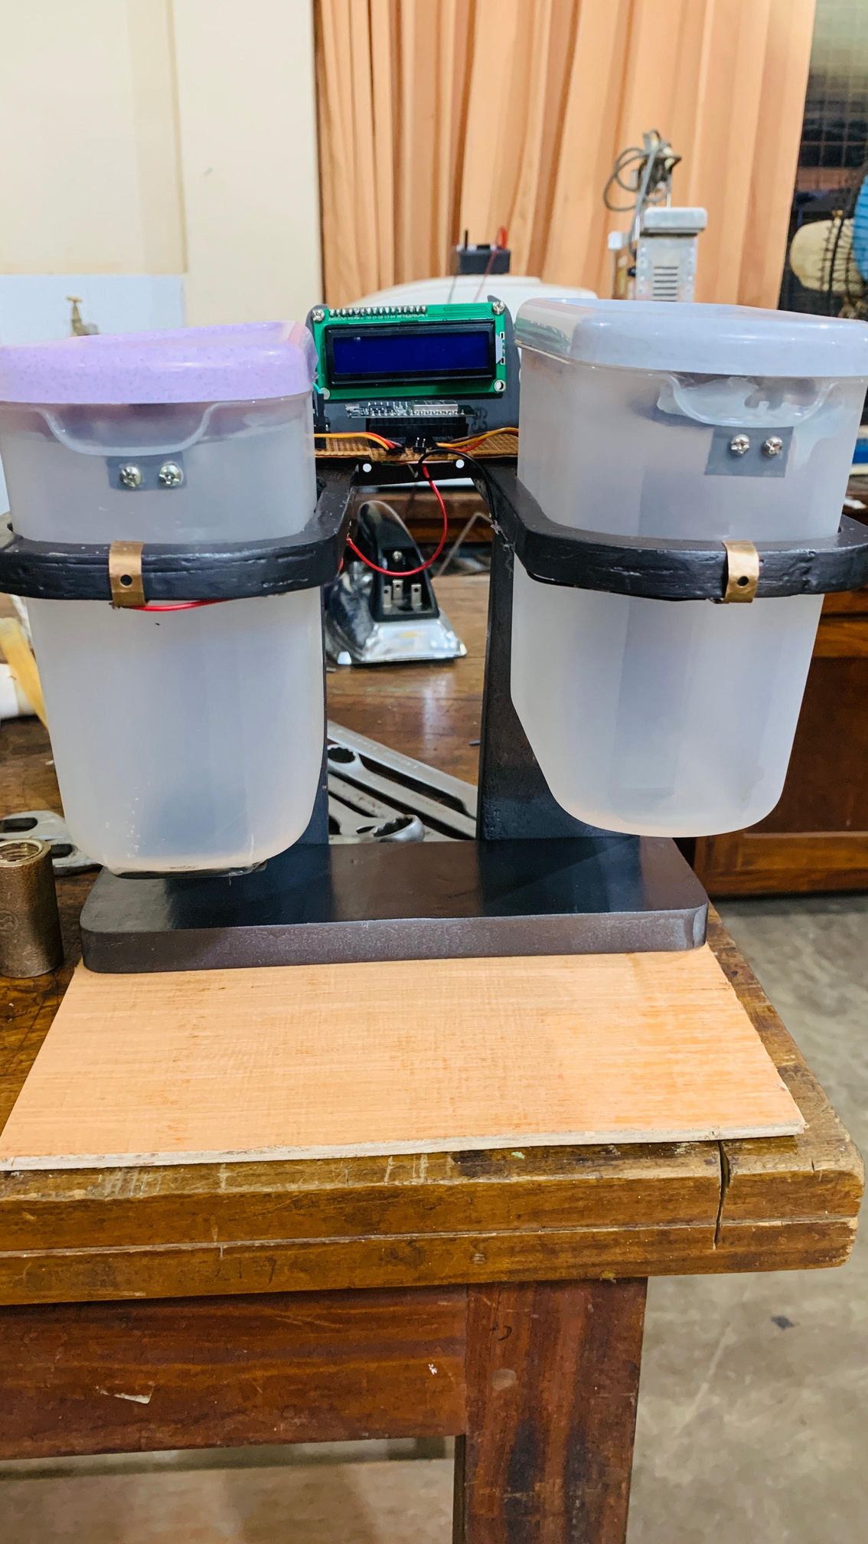



Why I choose this project idea
I chose this project because it addresses a practical problem in everyday life—managing kitchen inventory efficiently. With busy schedules, it's easy to lose track of stock levels, leading to wastage or last-minute shortages. This system provides a smart, automated solution to monitor inventory in real-time, notify users of low stock, and even suggest offers from supermarkets. It combines my knowledge of IoT, programming, and hardware to create a useful, innovative application that aligns with modern smart home trends.

Slide 3
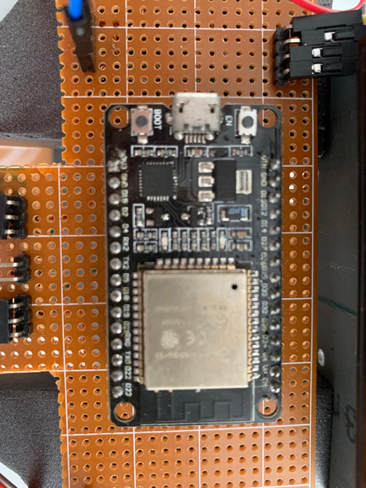
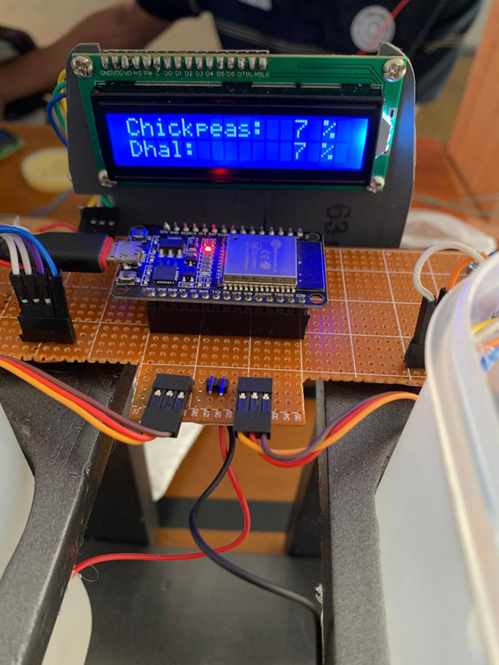

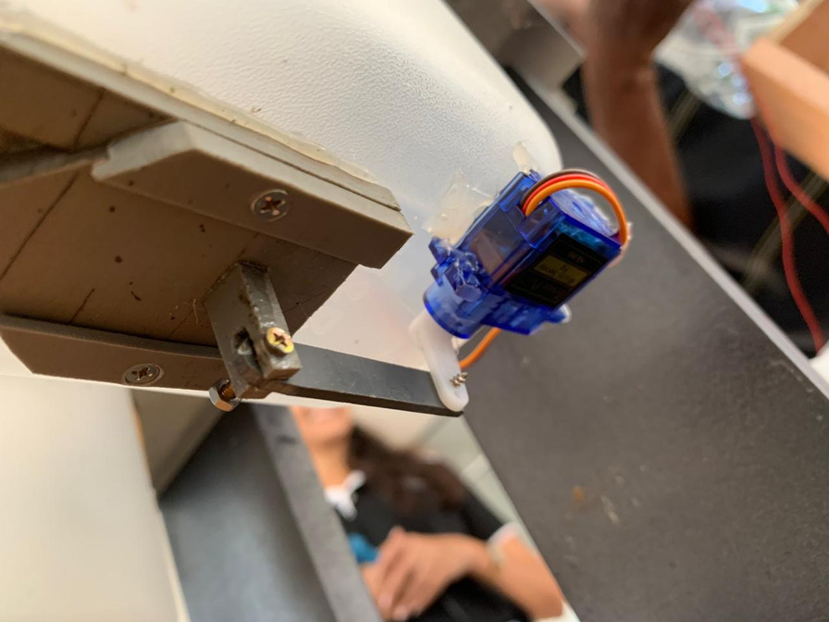
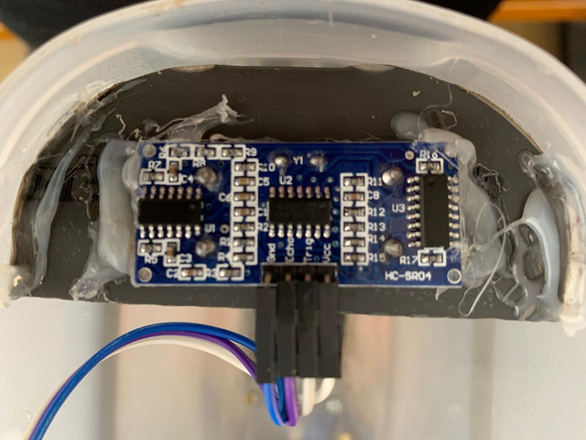
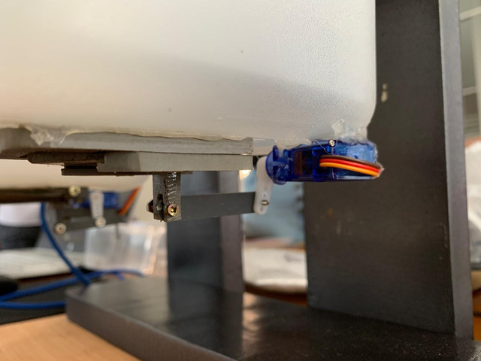
Components Used
LCD Screen
ESP 32 Board
Servo Motor
Ultrasonic Sensor
Automatic Opening Gate

Slide 4
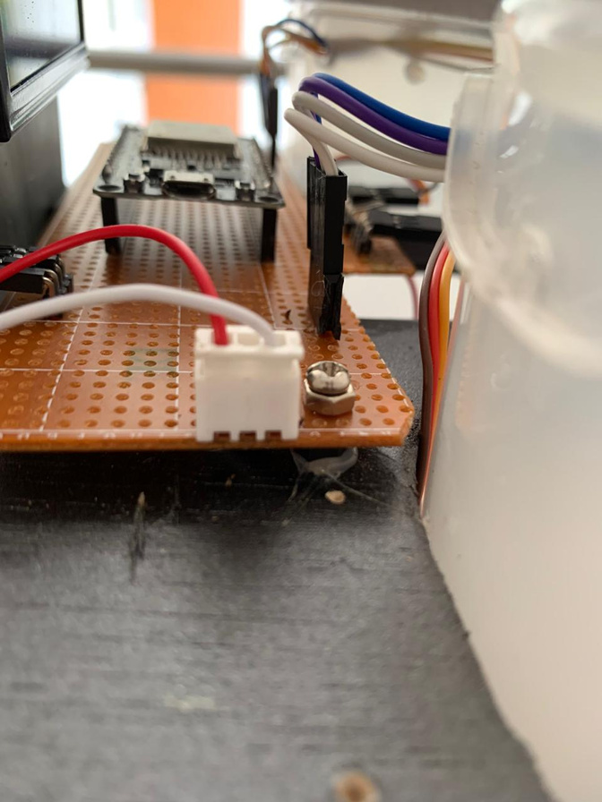
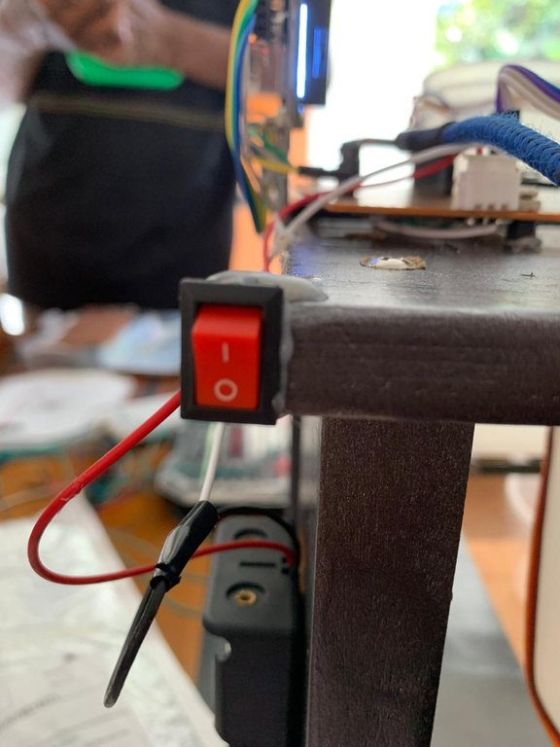
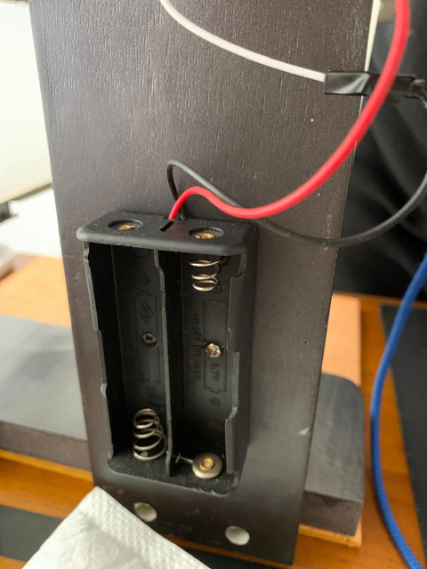
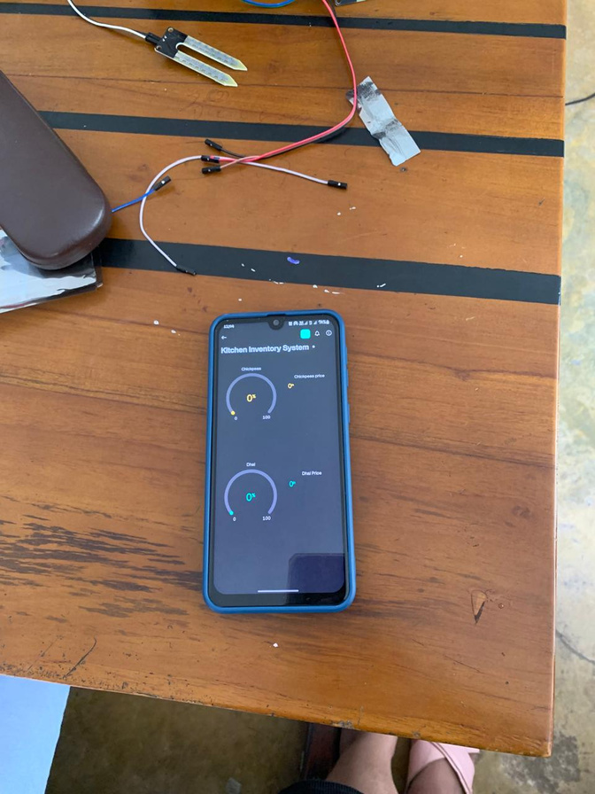
Components Used
Voltage Regulator
Switch
Blynk app
Battery pack

Slide 5
What are the functions in this project ?
Inventory Monitoring.
Inventory data is proceed to calculate the item remaining level as a percentage.
Real time data displaying in the mobile app and the LCD screen.
Automatic basket opening when the touch pin is activated.
Web scraping for the prices of the items and offers.

Slide 6
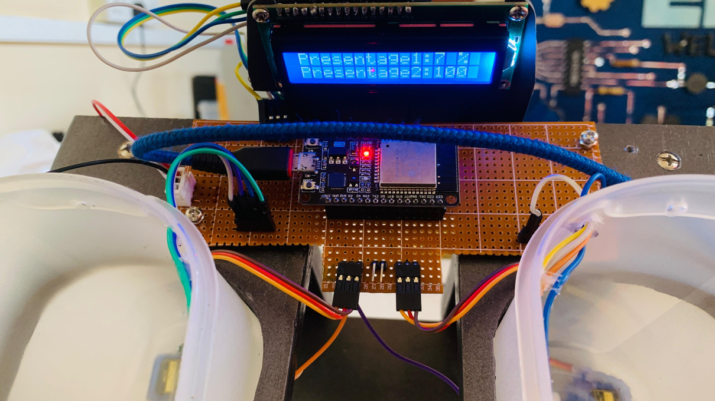
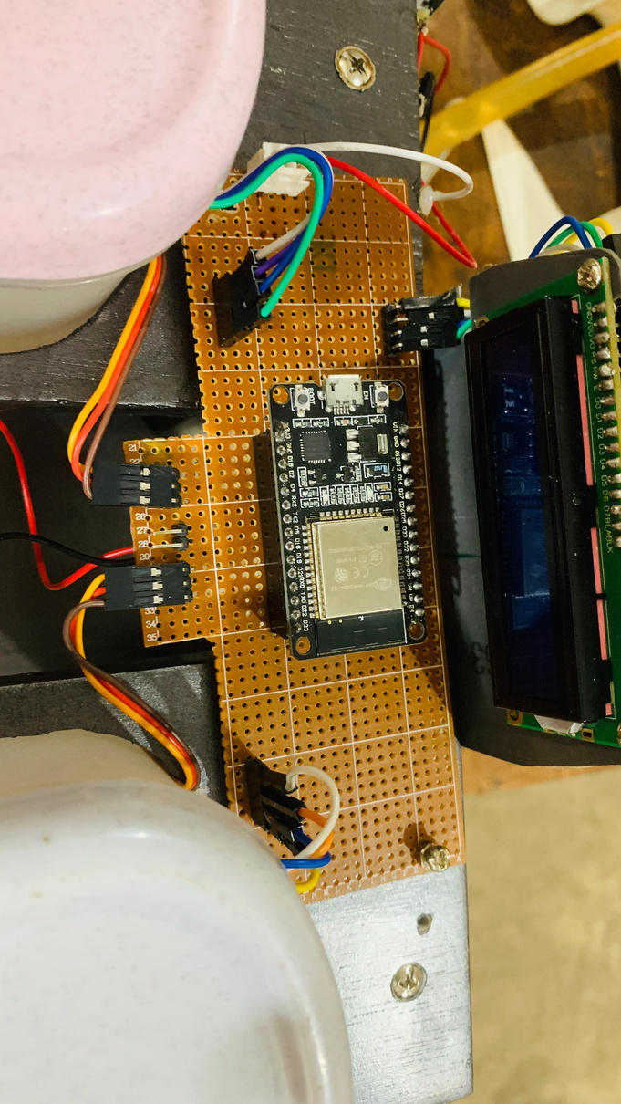
Pin Configuration
Servo Motor 1 -> ESP 32 board
SignalPin —> GPIO 13
Servo Motor 2 -> ESP 32 board
SignalPin —> GPIO 12
TouchPin -> ESP 32 board
GPIO 4
GPIO 15
Ultrasonic Sensor 1 -> ESP 32 board
TrigPin —> GPIO 5
EchoPin —> GPIO 18
Ultrasonic Sensor 2 -> ESP 32 board
TrigPin —> GPIO 26
EchoPin —> GPIO 25
LCD Display (I2C) -> ESP 32 board
SDA —> GPIO 21
SCL —> GPIO 22

Slide 7
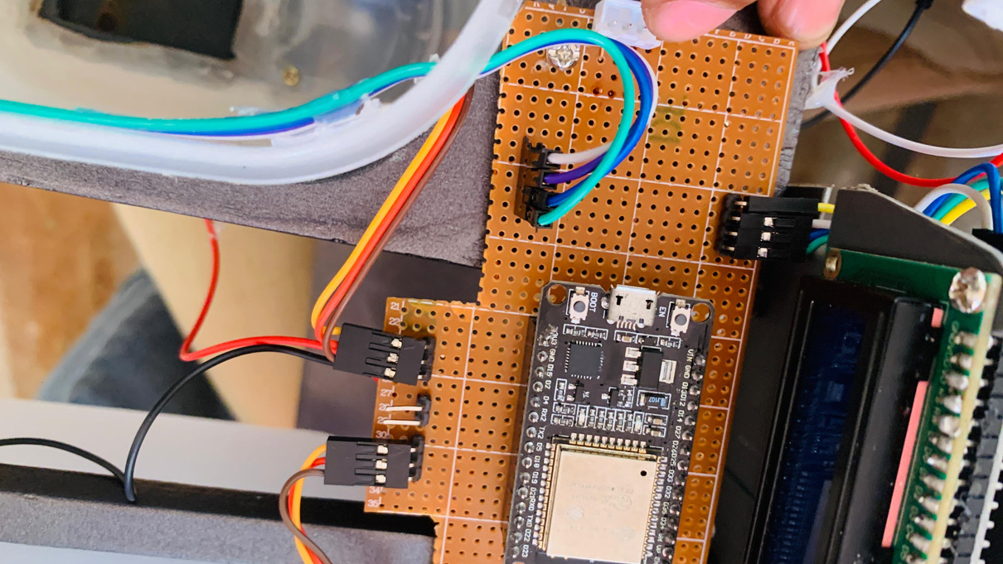
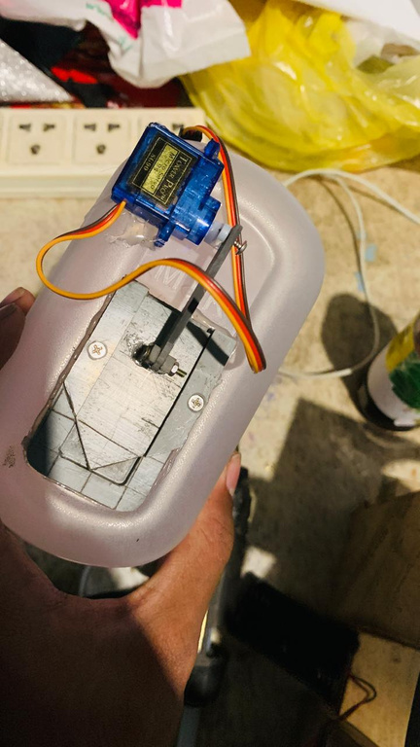
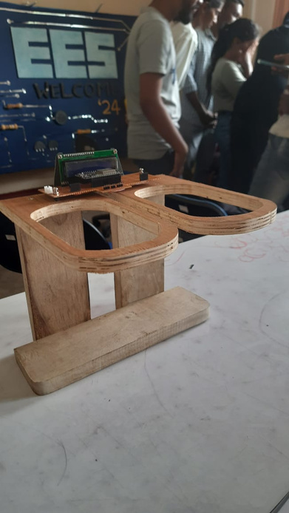

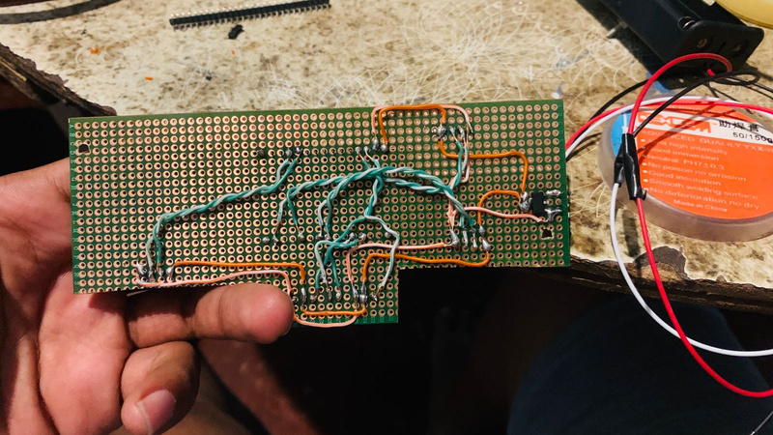
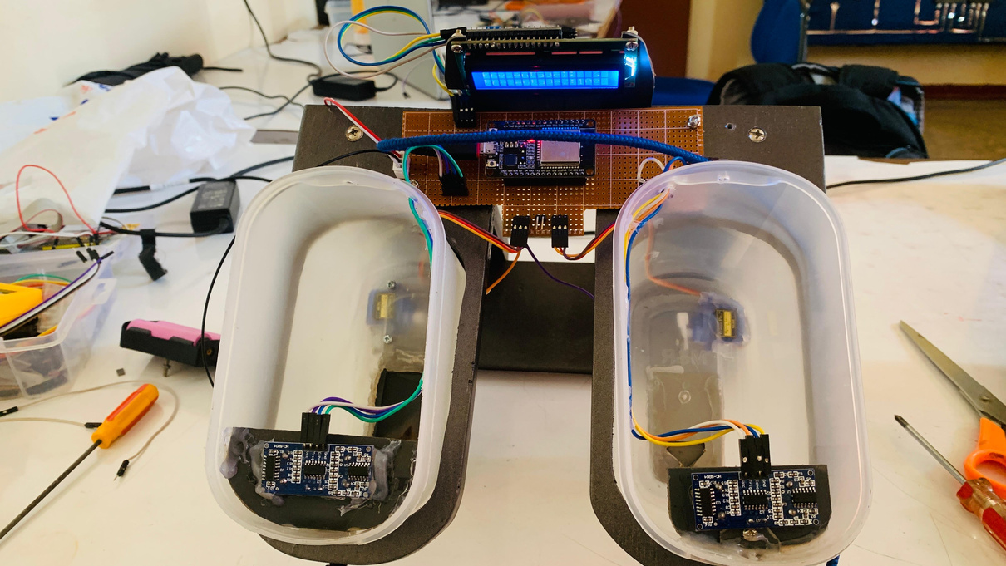
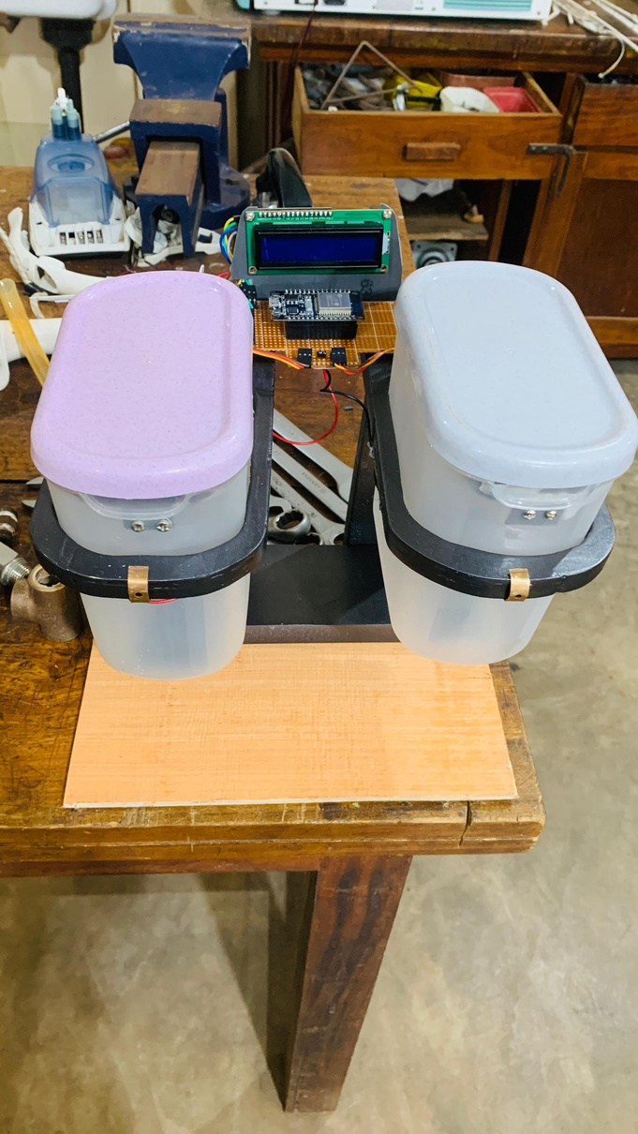
Visual Guide to Project Assembly

Slide 8

Future Work
Increasing amount of containers
Show the Web Scraping values
Expand Price Monitoring to Multiple Stores
Automatic bill creating

Slide 9
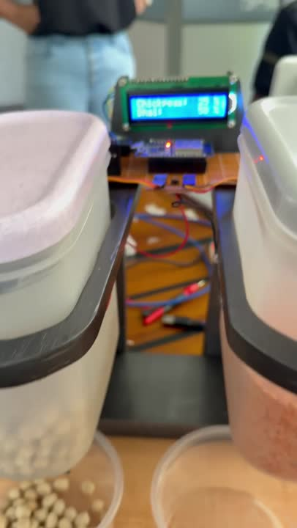
Video Guide

Slide 10
Thank You

